Slide 1
MINI Project - II
CookiT -- Cooking Recipes Viewing and Sharing Platform

Slide 2
TOC
Introduction
Abstract
Objective
Team Members
Acknowledgement
Technology Used
Diagrams
Screenshots
Conclusions
References

Slide 3
Introduction
We are going to work on a project where we will be developing a combination of a website and an android application that will allow its users to share and learn the cooking recipes of various cuisines they want to learn. Talking about more on our project it provides different functionalities to its user.
The users along with adding their recipes, choosing between some random ones to try out, or picking the best of the day can also add his/her recipe to the fray making it available to the world to try out. The technologies that are being used in this project or for the development of this project are Flutter (Dart based cross-platform development framework used to develop smartphone applications)with Firebase cloud service provider as database, user authenticator, and providing hosting for the website is going to be used for the backend.

Slide 4
Abstract
This project is related to the development of an android application and website where we are going to allow the users to view all different types of recipes as well as share their own with the world without having to go through the hassle of browsing through a lot of different type of websites for a different type of cuisines and wasting time.
This project is based on various technologies that include the cross-platform framework FLUTTER for the android application part while also making use of HTML, CSS, and JavaScript for the web part. For the backend, we are using Firebase, a cloud service provider by Google, and is used as BaaS(Background As A Service) in our project. Firebase is also used for other purposes such as hosting of the website, authentication, and Data Storage.

Slide 5
Objective
Objectives are important; they play a vital role in project completion as they lead to the desired output. While working on a project the objectives should be made clear so that at the end you can have an idea that what you were looking for is achieved or not.
What we are looking at as an objective in this project is that the user that comes to our platform must feel comfortable with its environment first of all.
Then the features or the functionalities that are going to be made available for our users must be not too hard to understand. All these factors are going to play an important role when we are looking for a platform that is easy to use.

Slide 6
Team Members
01
Vivek Sharma
181500820
02
Akarsh Singh Gangwar
18150055
03
Rushtam Singh
181500597

Slide 7
Acknowledgement
It is my pleasure to acknowledge the assistance of Mr. Anand Prakash Gupta without his guidance this project would not have been possible. First and foremost, I would like to express our gratitude to Mr. Anand Prakash Gupta My project guide, for providing invaluable Encouragement, guidance, and assistance. After doing this project I can confidently say that this experience has not only enriched me with technical knowledge but also has unparsed the maturity of thought and vision.
The attributes required being a successful professional.

Slide 8
Technology Used
This project is based on various technologies that include the cross-platform framework FLUTTER for the android application part while also making use of HTML, CSS, and JavaScript for the web part. For the backend, we are using Firebase, a cloud service provider by Google, and is used as BaaS(Background As A Service) in our project. Firebase is also used for other purposes such as hosting of the website, authentication, and Data Storage.

Slide 9
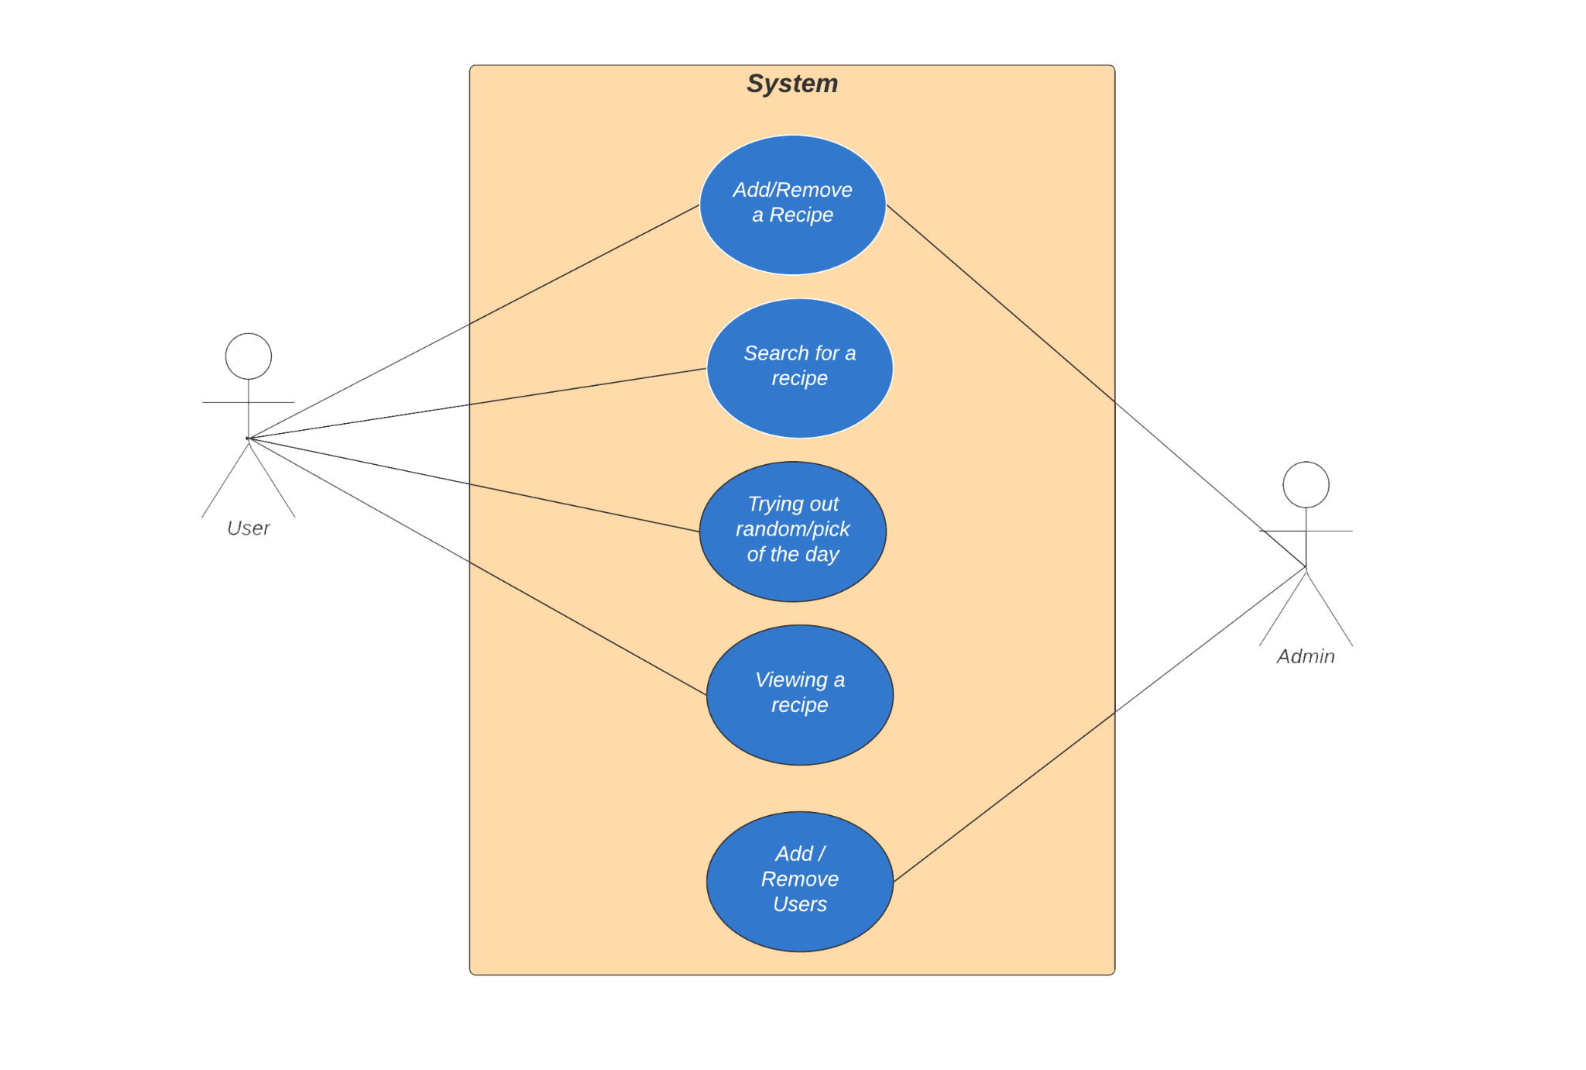
Diagrams -- Use Case Diagram

Slide 10
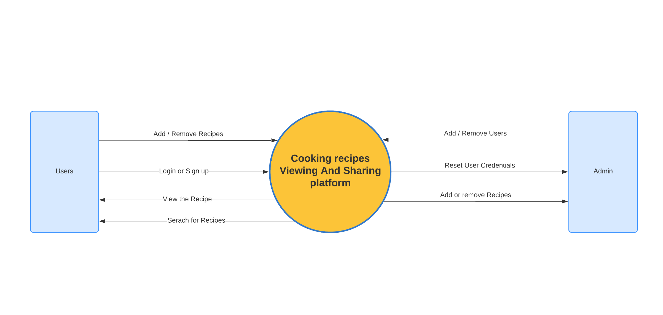
Diagram -- DFD Level 0

Slide 11
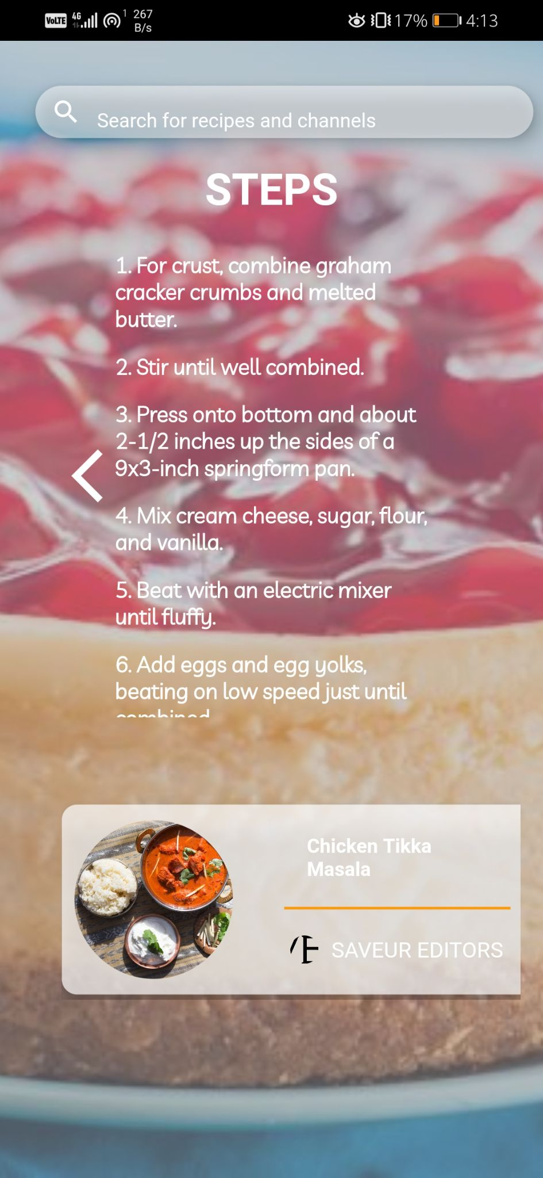
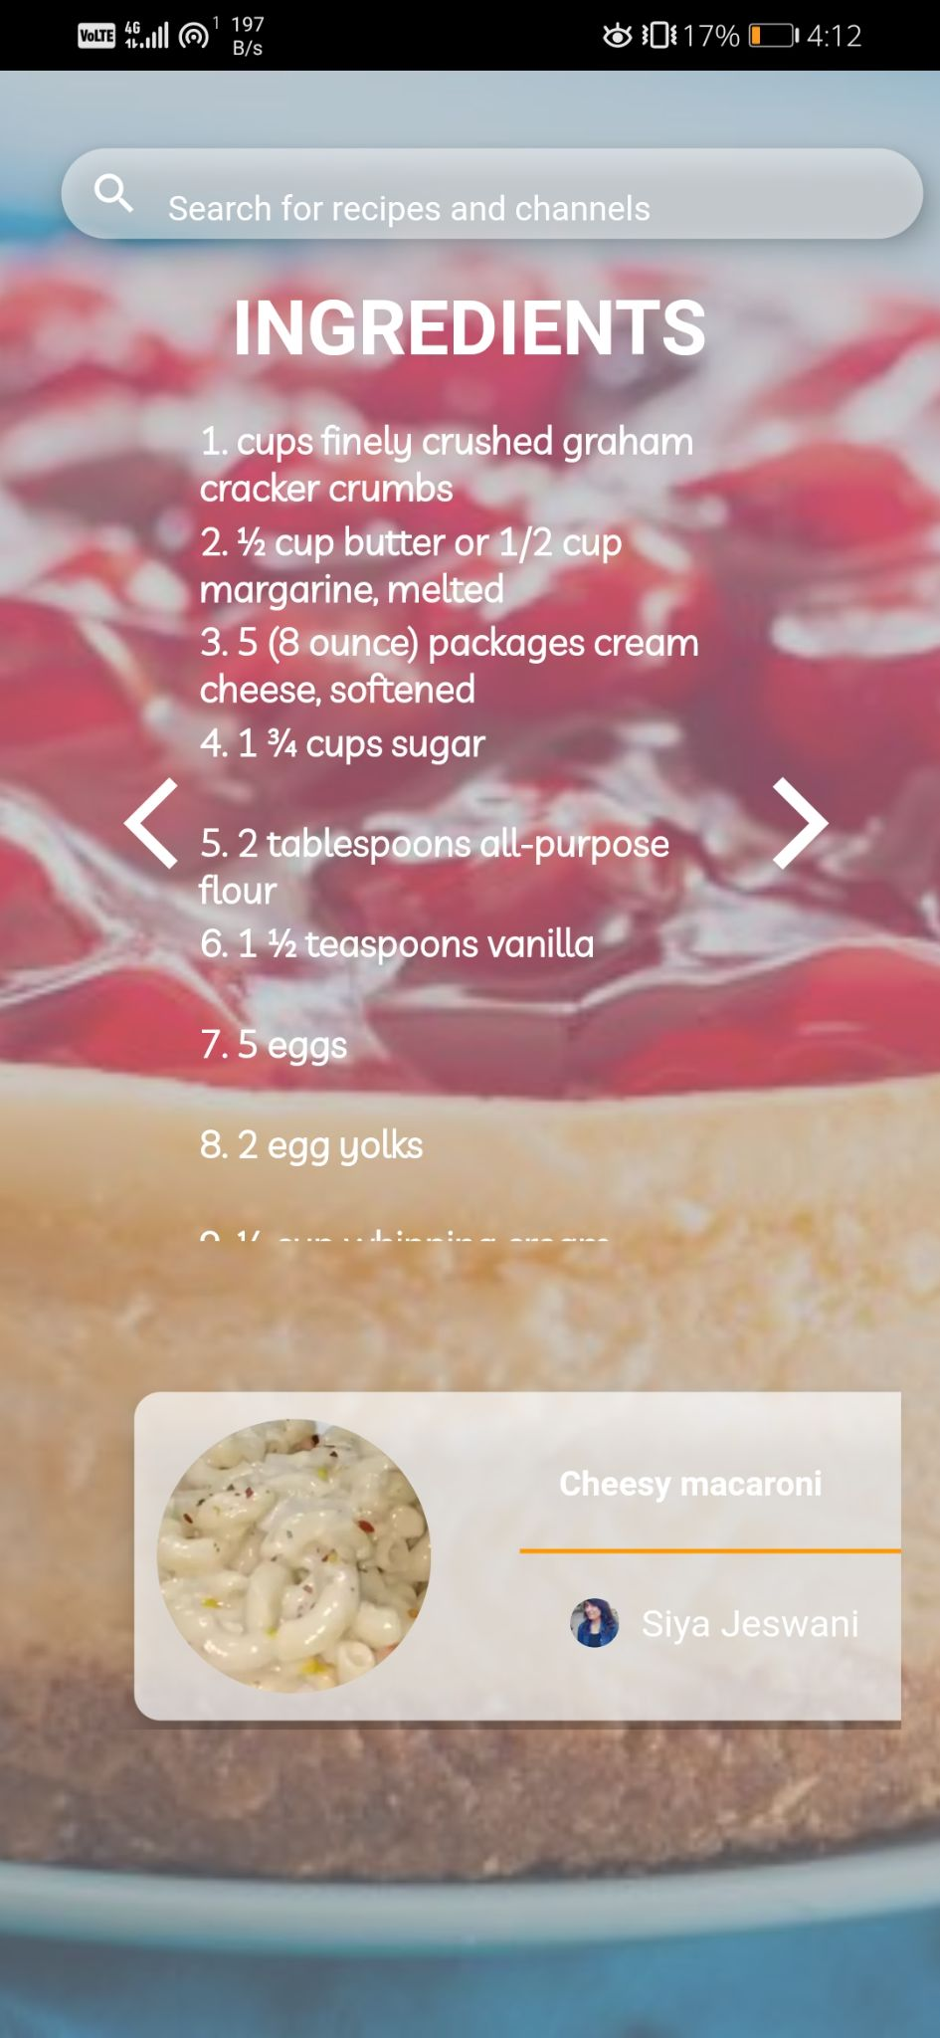
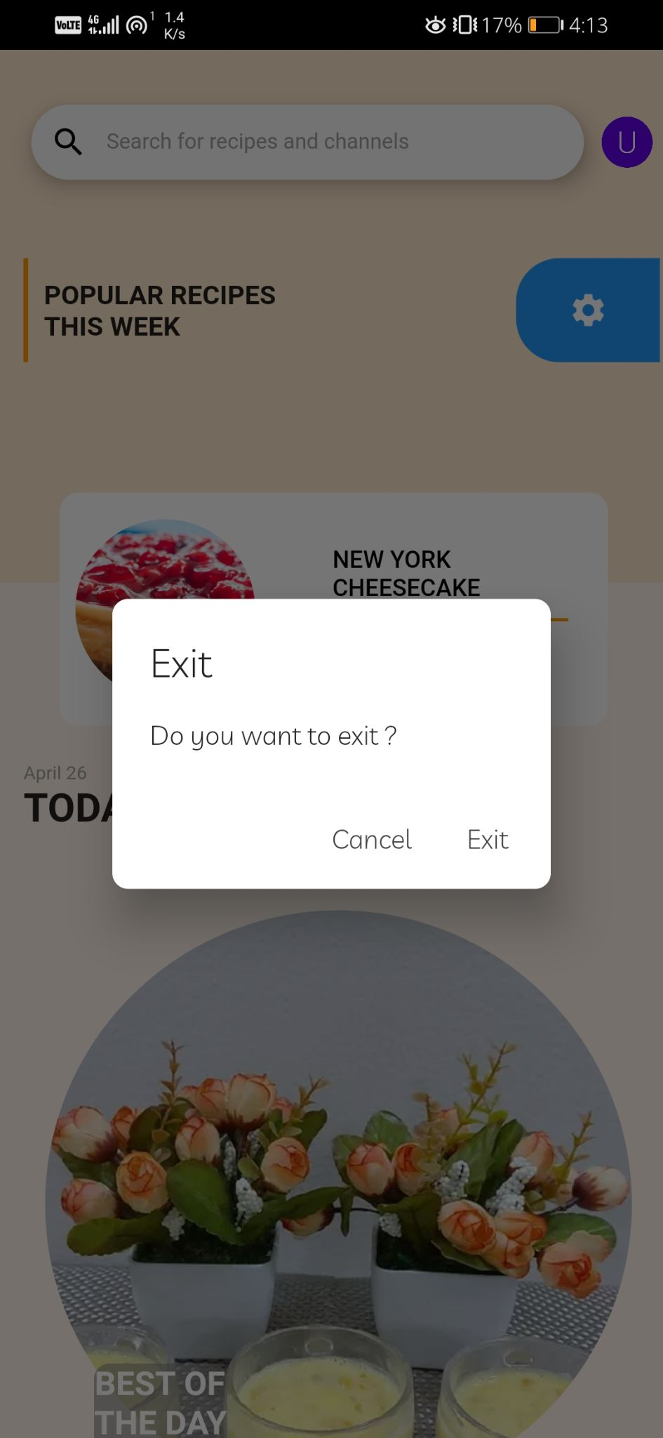

Slide 12
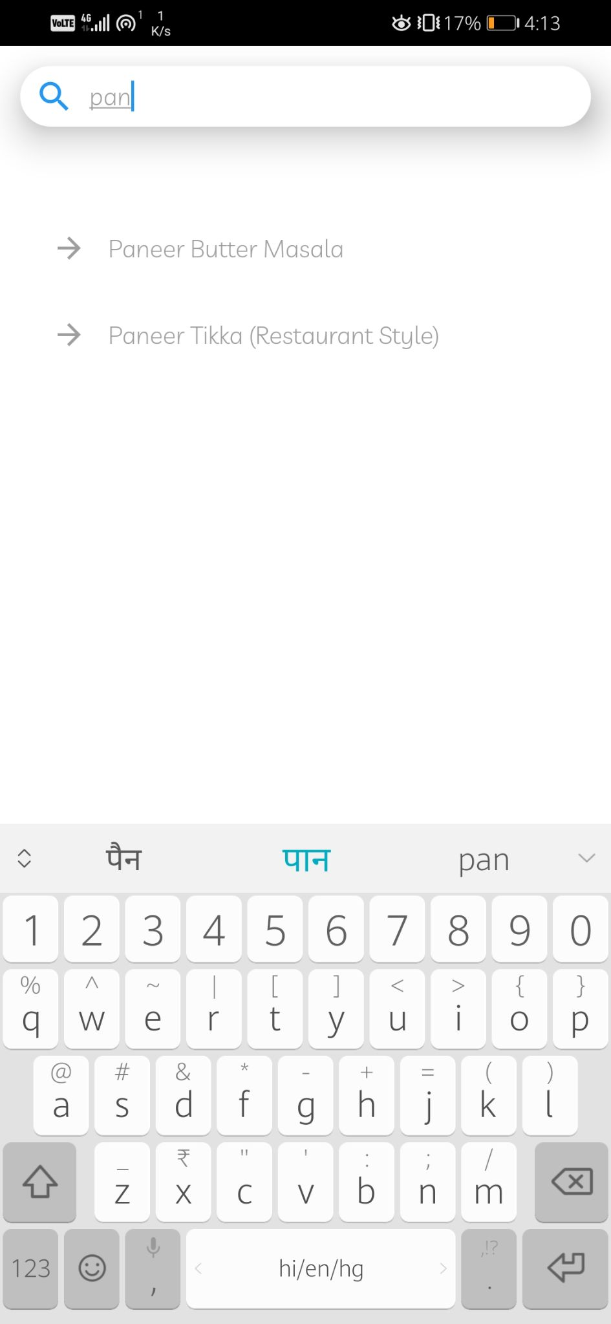
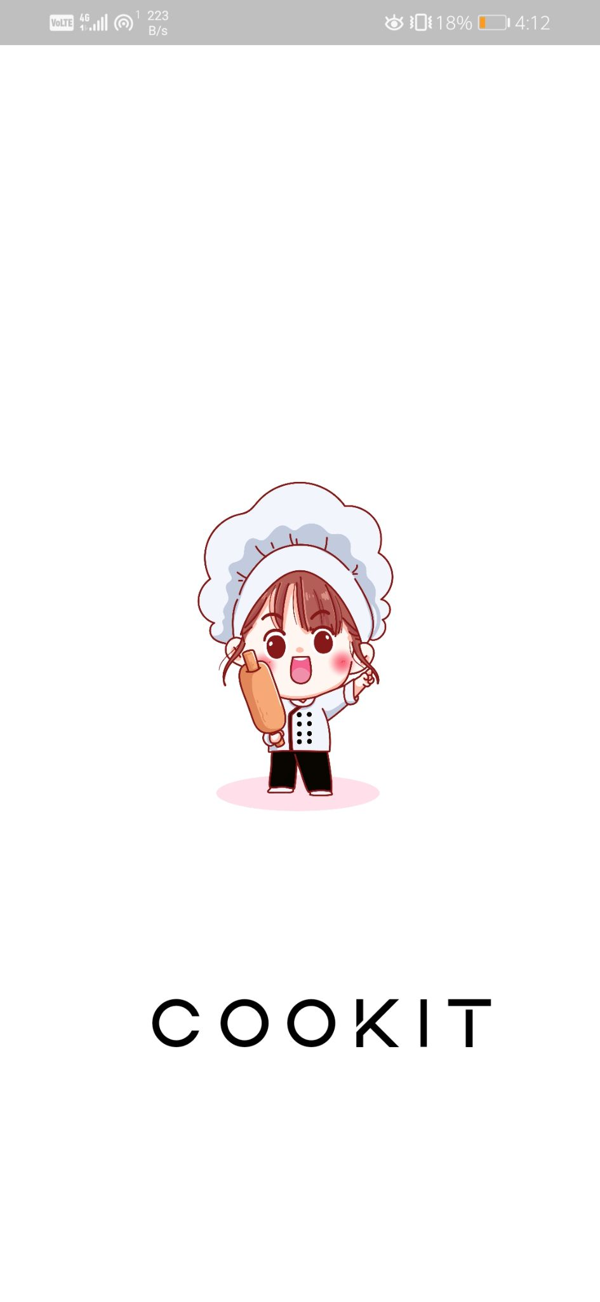
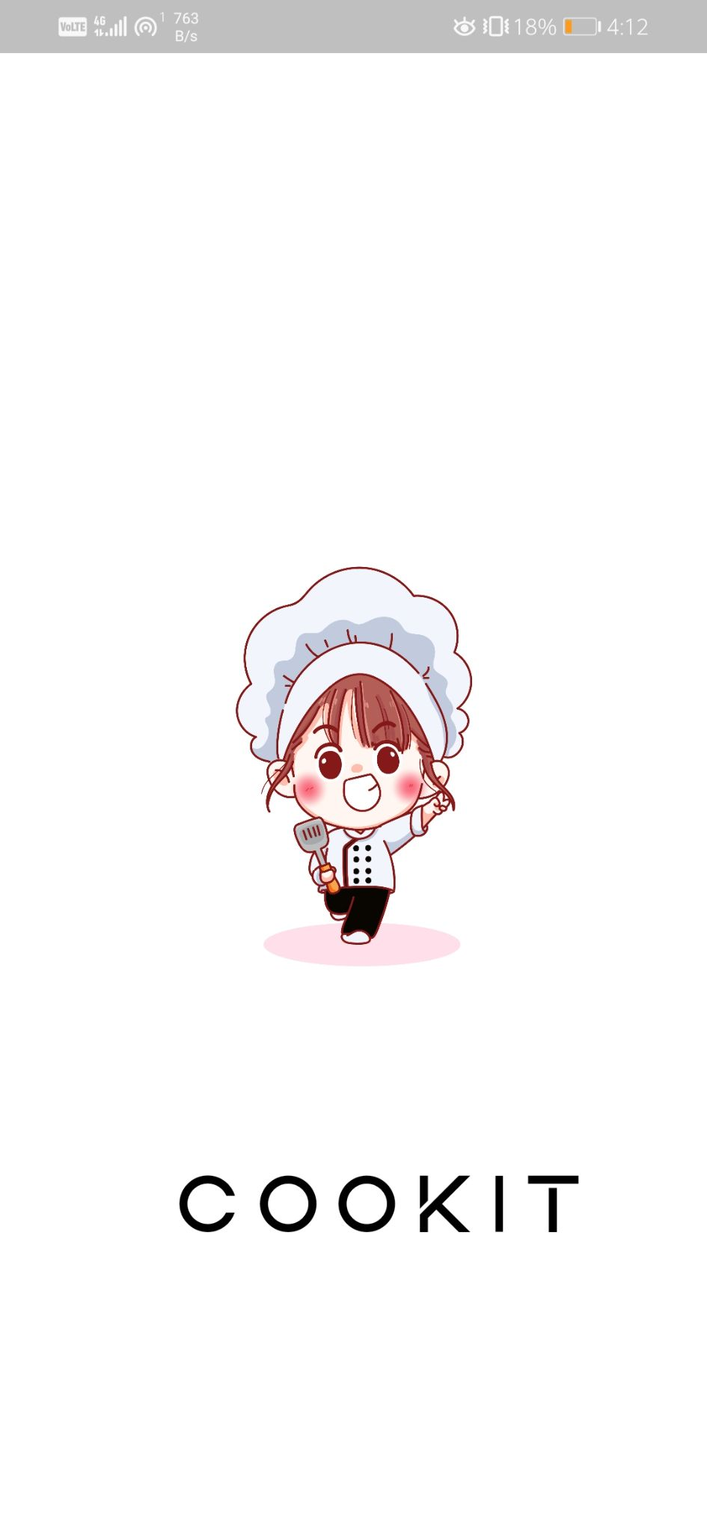
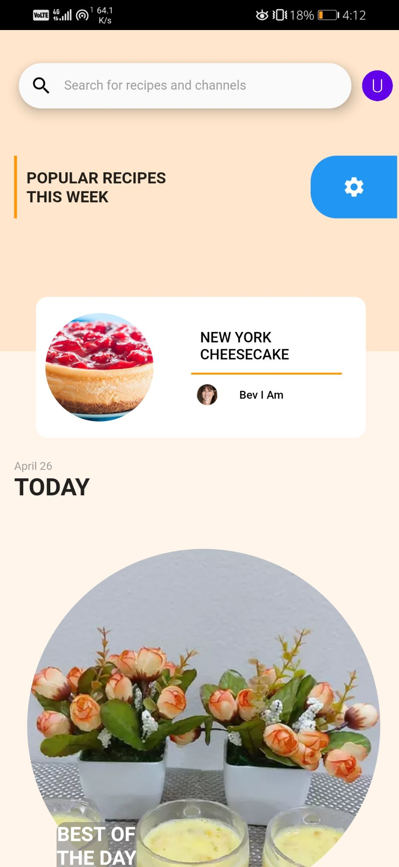
Implementation Screenshots

Slide 13
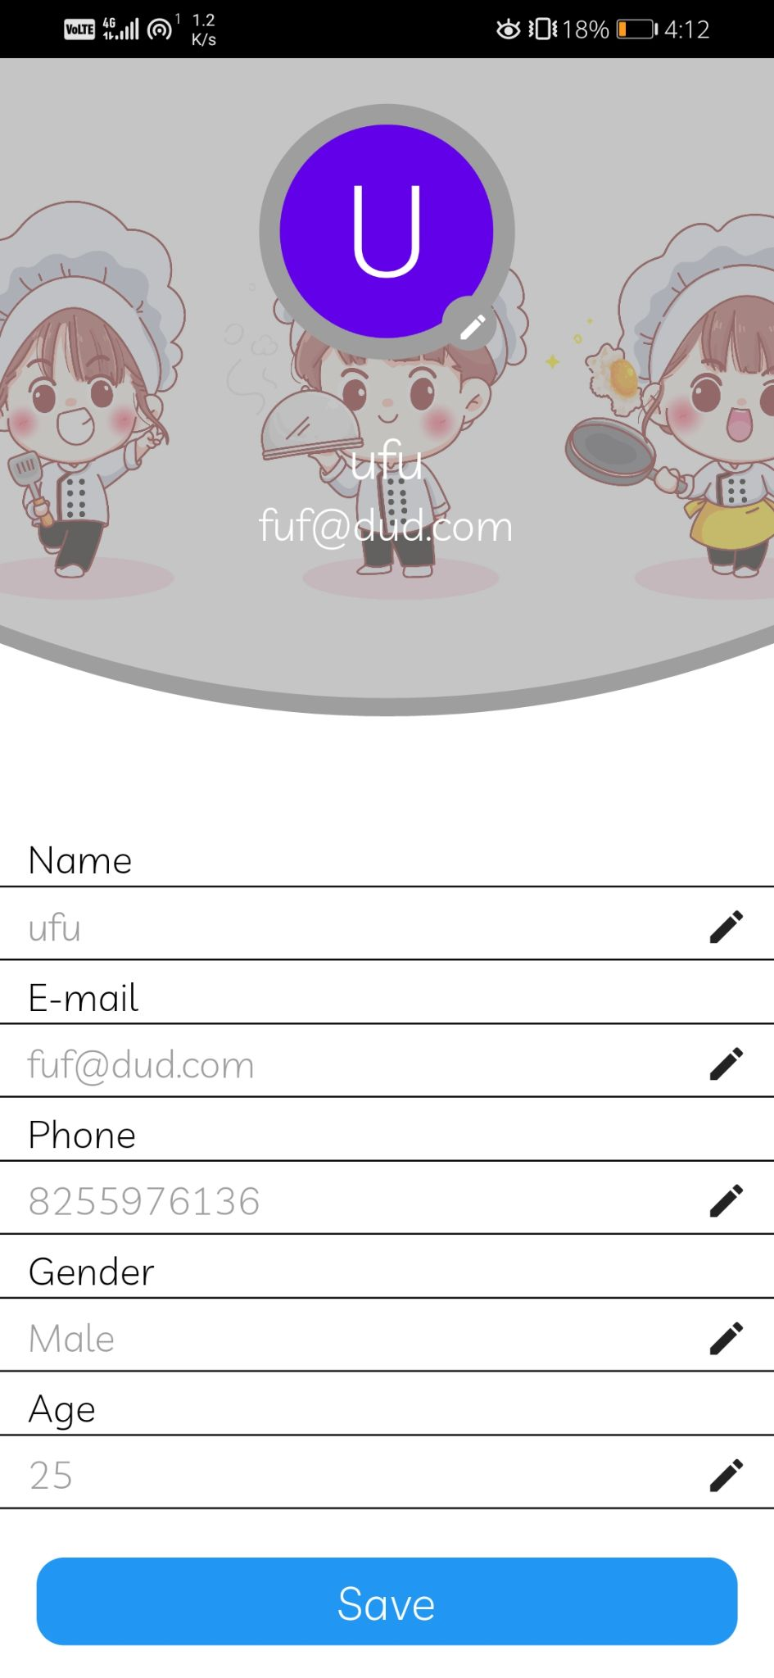
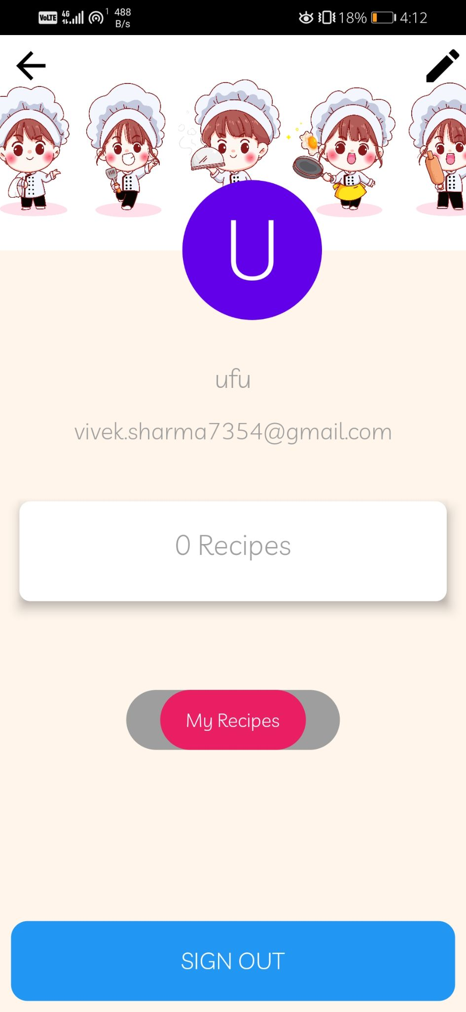
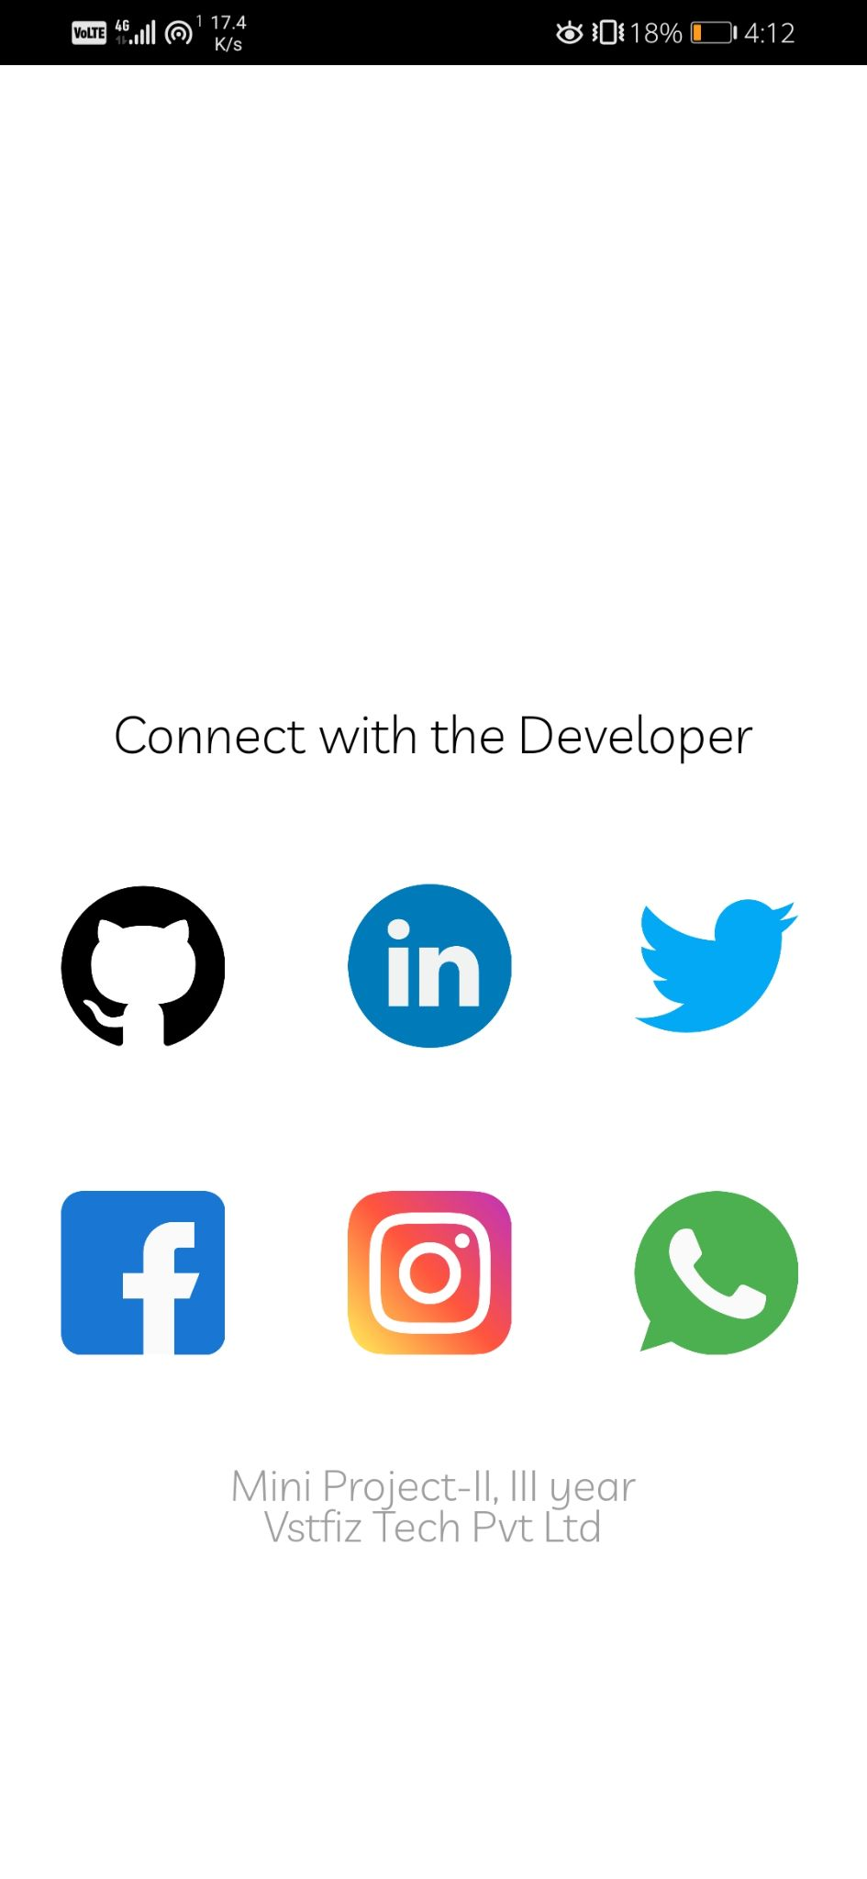

Slide 14
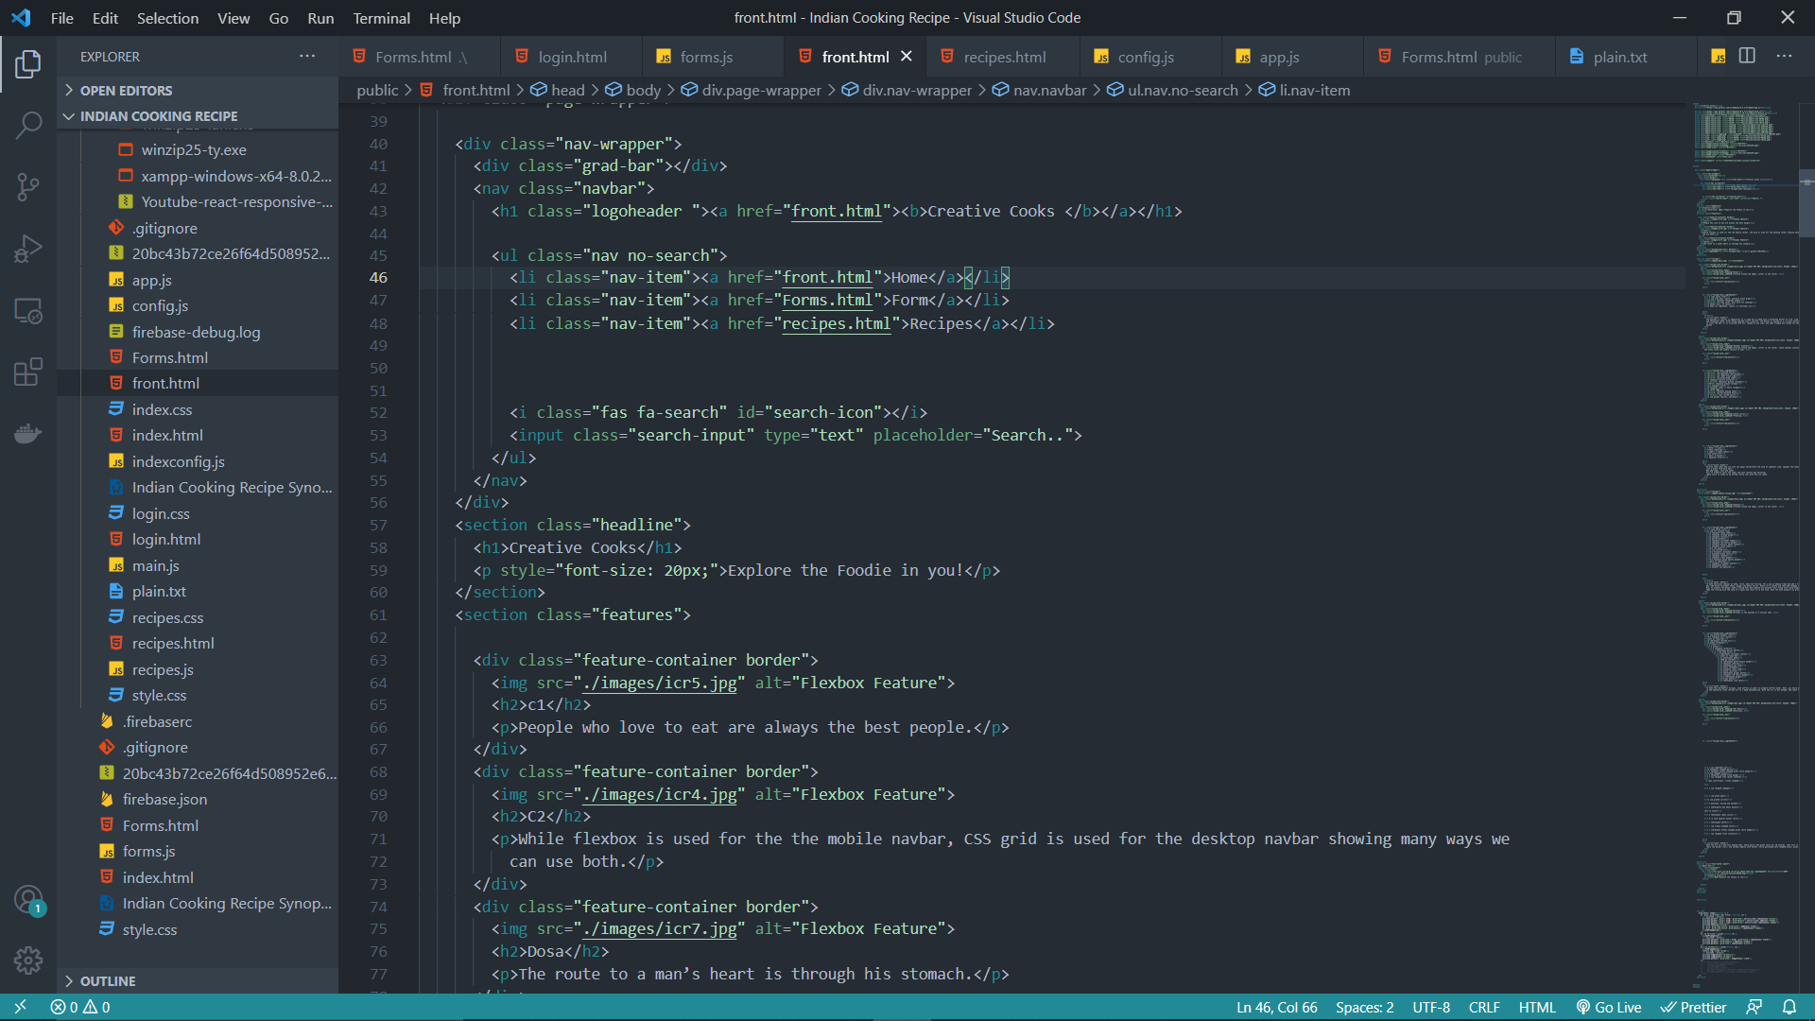
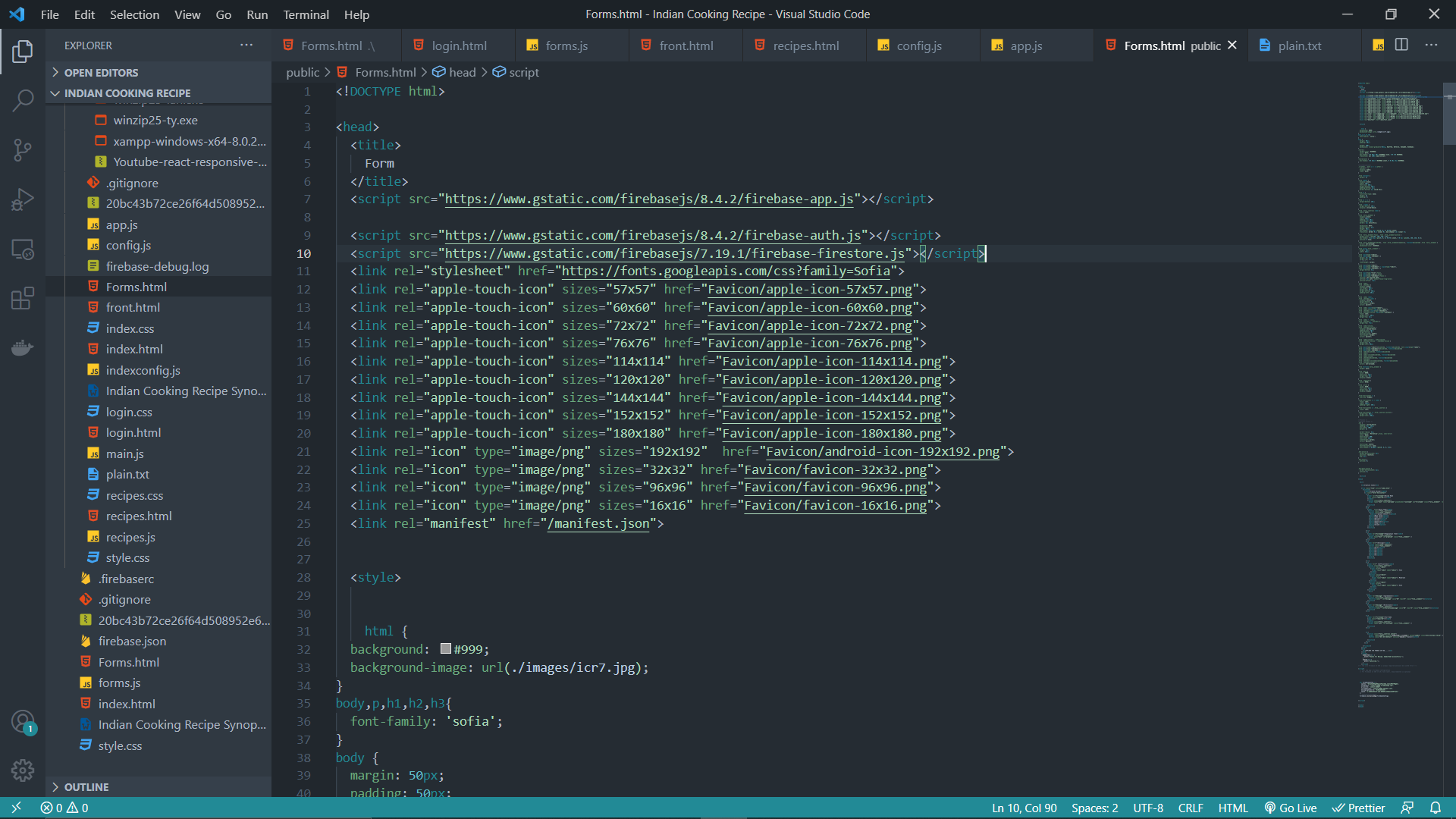
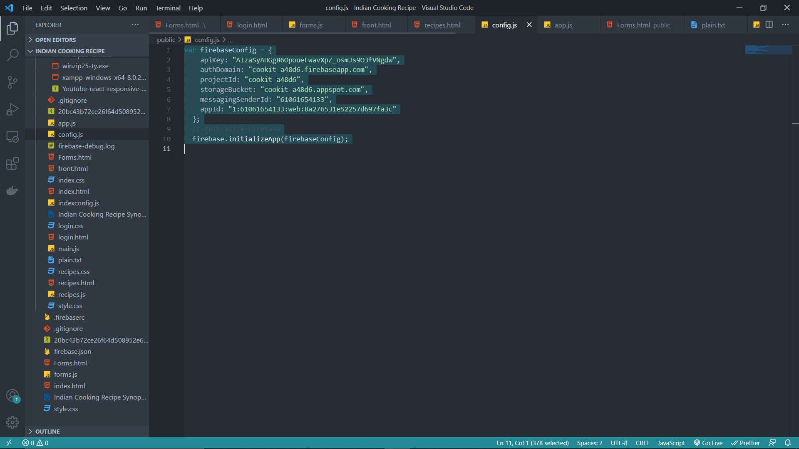
Coding Part

Slide 15
Conclusion
In the conclusion, we can say that we learned a lot during our working period on this project. We got to know a lot of things that we didn’t know before working on this project. This project has some technologies that are good to try your hands on. The final platform that is ready to be used by the users is having a friendly environment where one can easily add the recipes, can delete them, the viewer can see them, and in a future comment over the recipes, they can also follow the content creator and a lot more features are to be there over the platform. Overall the platform is best suitable to be used in daily lives and surely will be a good preferable one in future.

Slide 16
References
www.freepik.com
www.dribbble.com
www.stackoverflow.com
www.flutter.dev

Slide 17

Thank you!
Feel free to ask any due questions.

